Slide 1

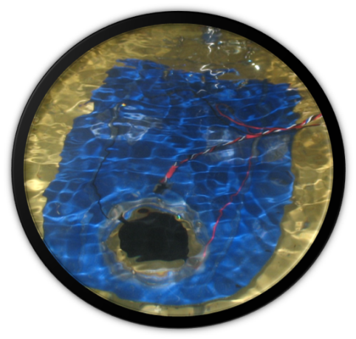
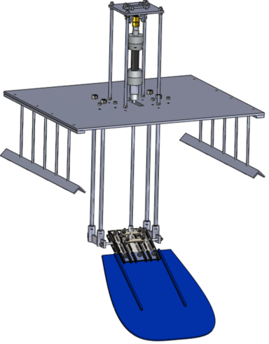

Dielectric Elastomer Sensors For Aquatic Propulsion Systems
Mahdieh Nejati
Supervised By:
Dr. Iain Anderson

Slide 2
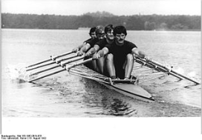
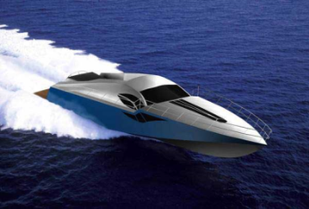
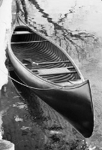
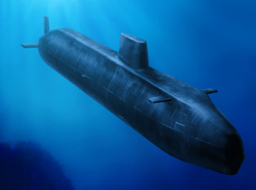
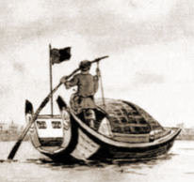
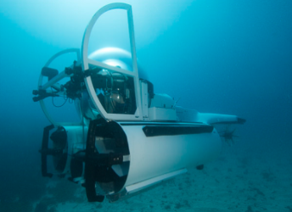
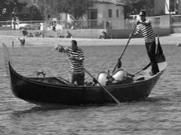
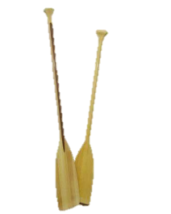
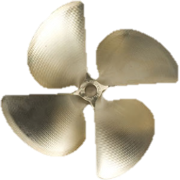
Marine Propulsion
European Row boat
Limitations:
Lack of maneuverability
Lack of obstruction avoidance
Lack of flow tracking
Corrosion
Disturbance to marine life
Indian Canoe
Chinese Sampan
Venetian Gondola
Marine Propulsion Technological Advances
Oars
Propellers

Slide 3
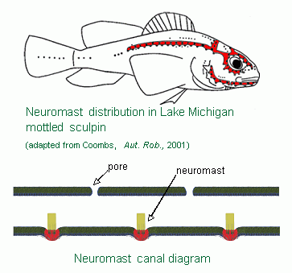
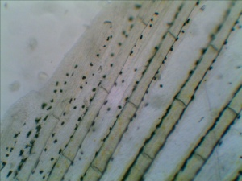
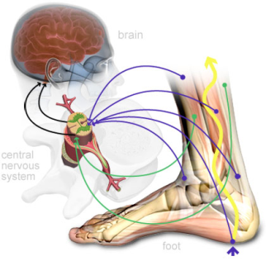
Fish Sensing
Lateral Line System
Proprioception
Avoid obstacles
Detect prey
Active propulsion and maneuverability
Intro
Aim
Design
Behavior Analysis
Results
Future Potentials

Slide 4
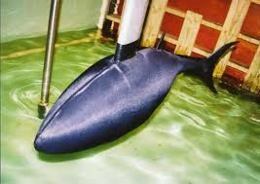
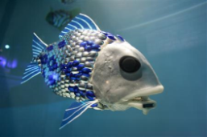

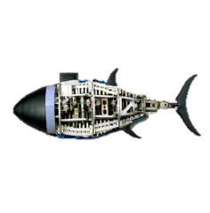
Marine Biomimetics
European Row boat
MIT Robotuna
?
Indian Canoe
University of Essex
Chinese Sampan
Festo Airacuda
Venetian Gondola
Marine Propulsion Technological Advances
Oars
Propellers
Biomimetics

Slide 5
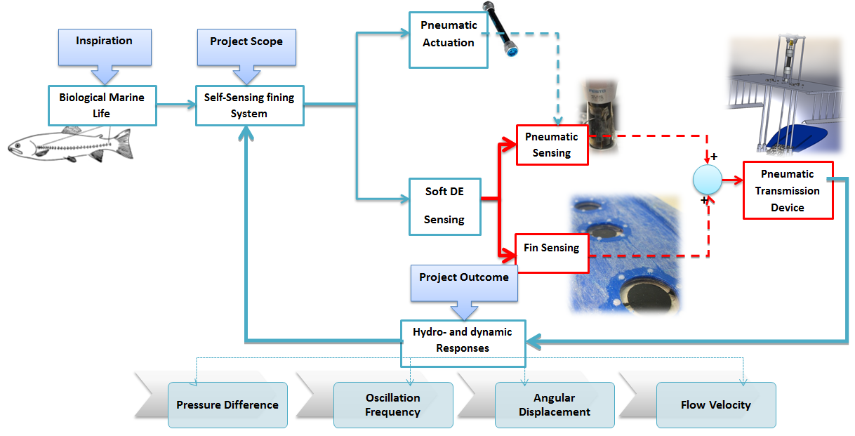
Project Plan
?
Intro
Aim
Design
Behavior Analysis
Results
Future Potentials

Slide 6
Project Aim
The Parallel Development of Two Types of Soft Sensors
Soft Aquatic Pressure Sensor
Why?
Soft Strain Gauge Coupled with Soft Actuator
Why?
Answer: The Lateral Line
Answer: Proprioception
Intro
Aim
Design
Behavior Analysis
Results
Future Potentials
Notes:
<number>

Slide 7
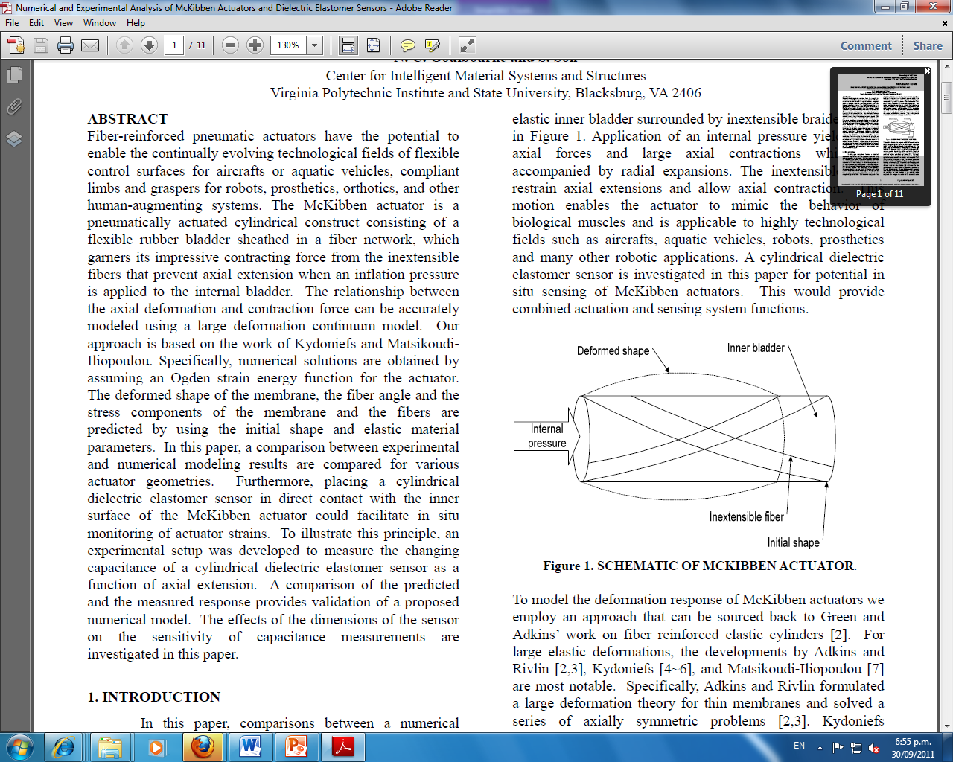
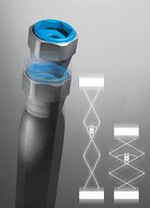
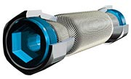
Pneumatic Artificial Muscles
Intro
Aim
Design
Behavior Analysis
Results
Future Potentials
Notes:
<number>

Slide 8

Dielectric Elastomer Capacitive Sensor
Elastic Dielectric
Flexible electrodes
Change in Output Capacitance
Applied Pressure and Sensor Deformation
+
+
+
+
+
+
+
+
-
-
-
-
Change in Gap and Overlap Area
Animation from Thomas McKay
-
-
-
-

Slide 9
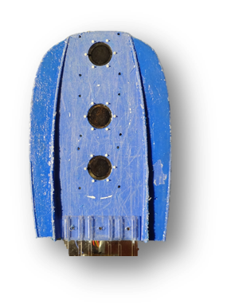
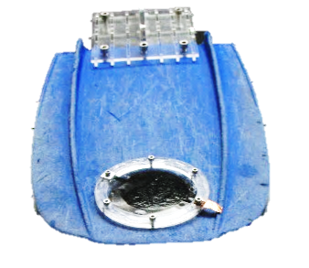
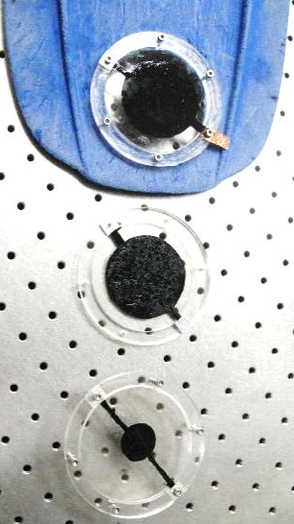
How Are DE Pressure Sensors Made?
Tested:
Sensor Diameter
Number of Layers
Electrode Material
Intro
Aim
Design
Behavior Analysis
Results
Future Potentials

Slide 10
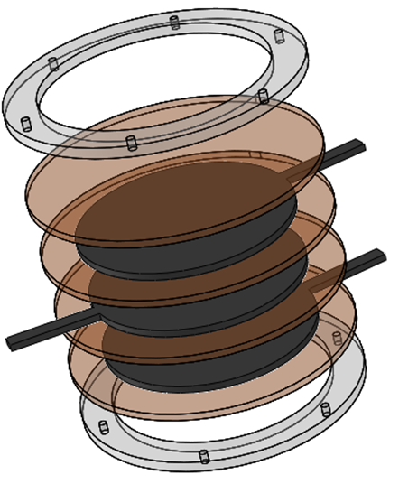
How Are DE Pressure Sensors Made?
Acetate/Perspex Frame
Carbon Grease/ RTV con-60 Electrode
VHB Dielectric Membrane
Intro
Aim
Design
Behavior Analysis
Results
Future Potentials

Slide 11
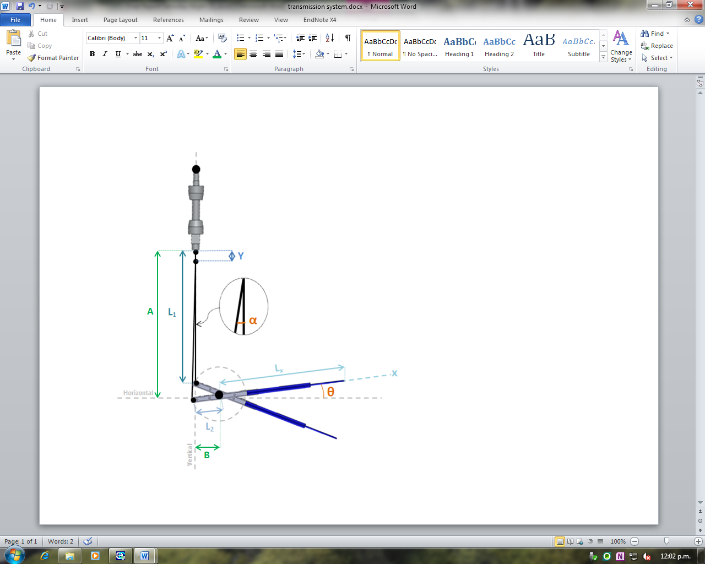
How Are the Two Sensors Coupled Within One Device?
Intro
Aim
Design
Behavior Analysis
Results
Future Potentials

Slide 12
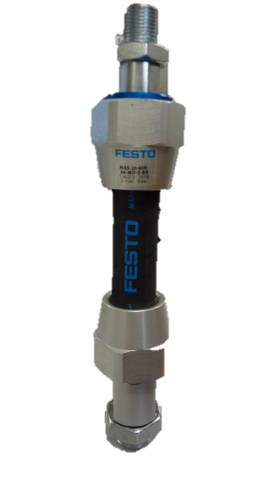
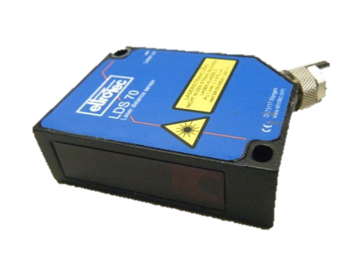


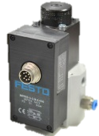
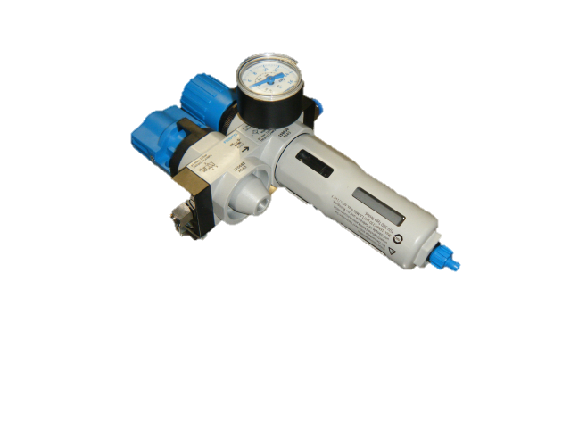
How were the DE Displacement Sensors Tested?
Pneumatic Artificial Muscle Coupled with
DE Displacement Sensor
Laser Displacement Sensor
Labview Program
Air Supply
DAQ Board
Proportional Pressure Regulator
Air Valve and Switch
Intro
Aim
Design
Behavior Analysis
Results
Conclusion
Future Work

Slide 13
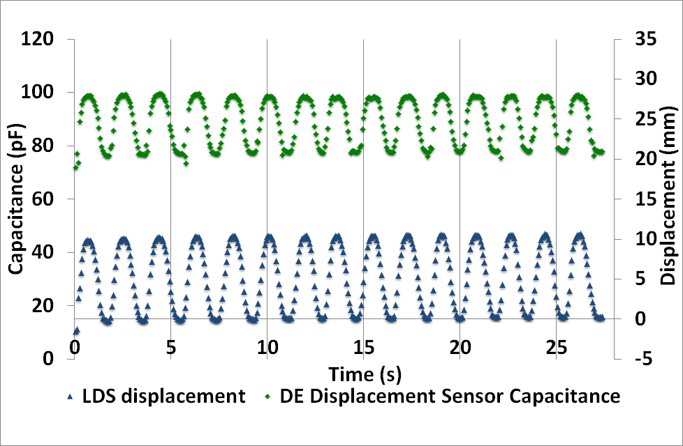
DE Displacement Sensors Show Linear Correlation with Displacement
Intro
Aim
Design
Behavior Analysis
Results
Conclusion
Future Work

Slide 14
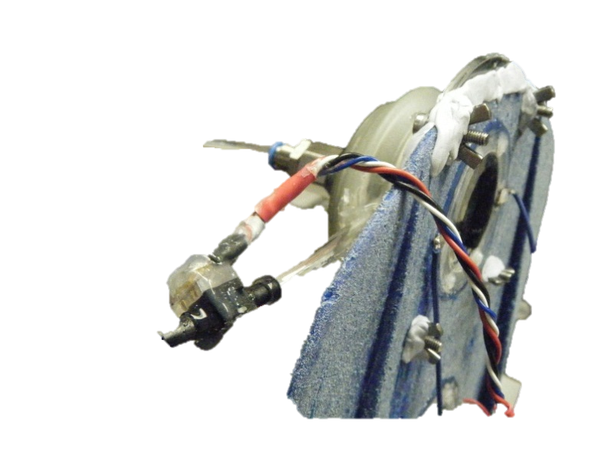

How were the DE Pressure Sensors Tested?
Calibration Device
Air Supply
DE Sensor
Pressure Sensor
Intro
Aim
Design
Behavior Analysis
Results
Conclusion
Future Work

Slide 15
DE Pressure Sensors Show Direct Correlation with Applied Pressure
Intro
Aim
Design
Behavior Analysis
Results
Conclusion
Future Work
Notes:
<number>

Slide 16
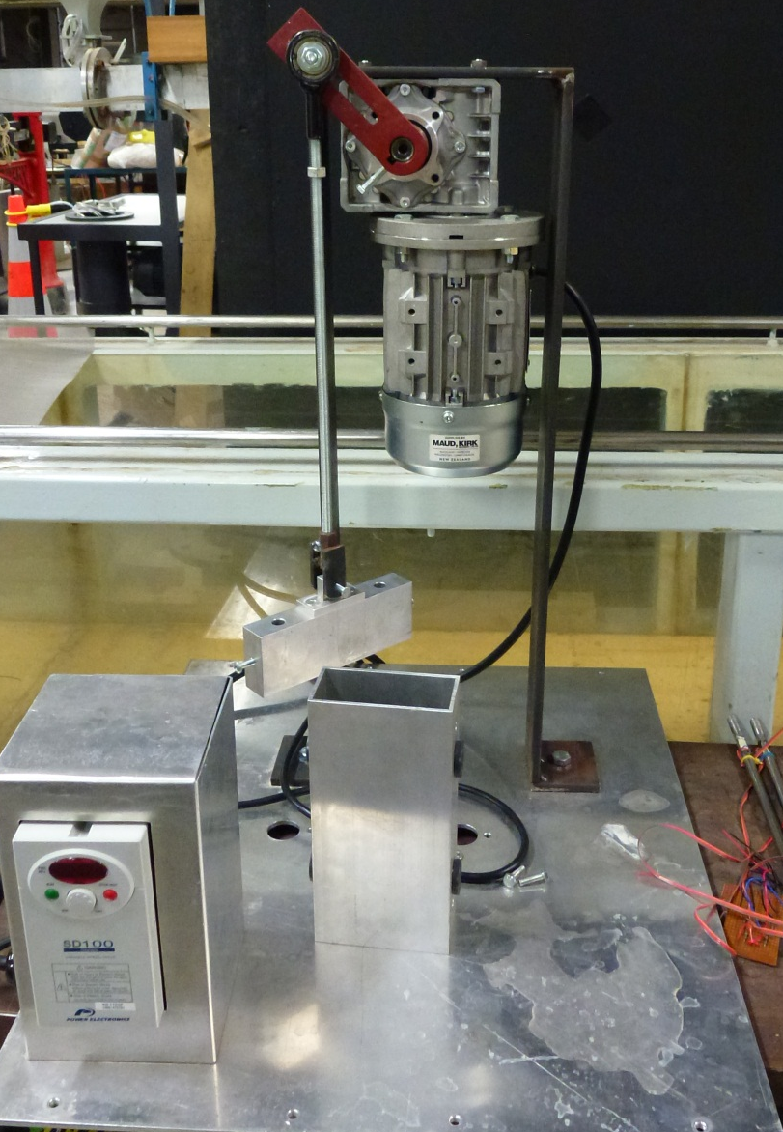
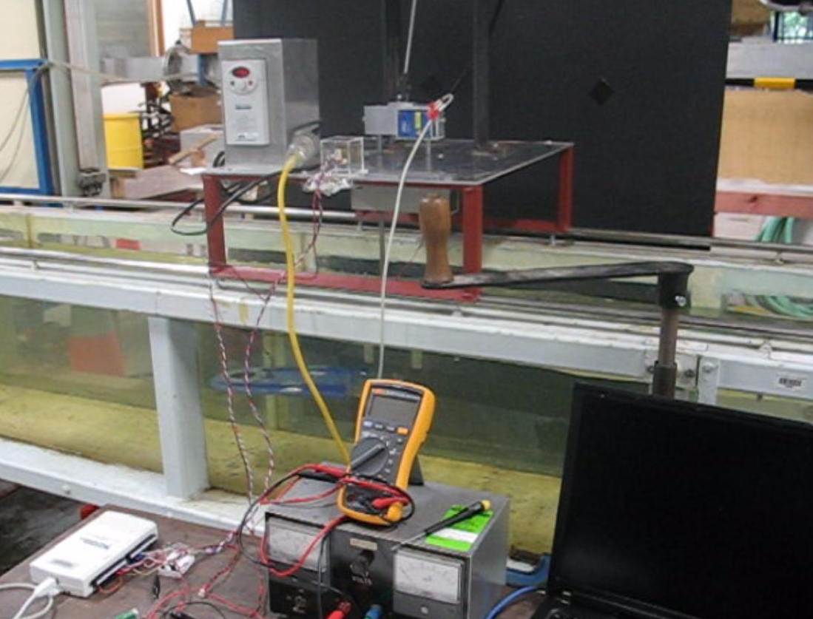
Motor and Gearbox Transmission System is Complex
Intro
Aim
Design
Behavior Analysis
Results
Conclusion
Future Work
Notes:
<number>

Slide 17
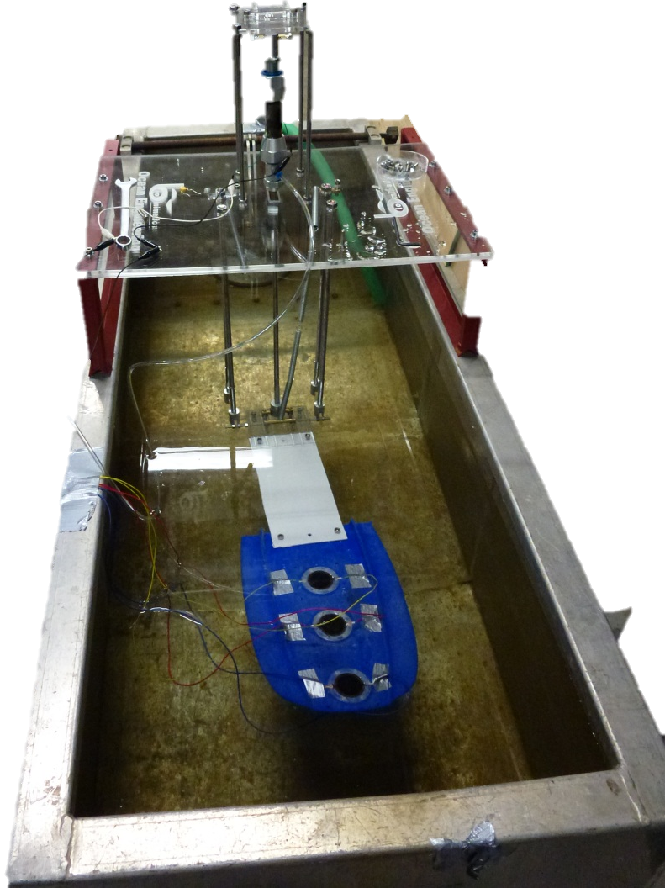
Pneumatic Finning System is Light weight and Compact
Intro
Aim
Design
Behavior Analysis
Results
Conclusion
Future Work
Notes:
<number>

Slide 18
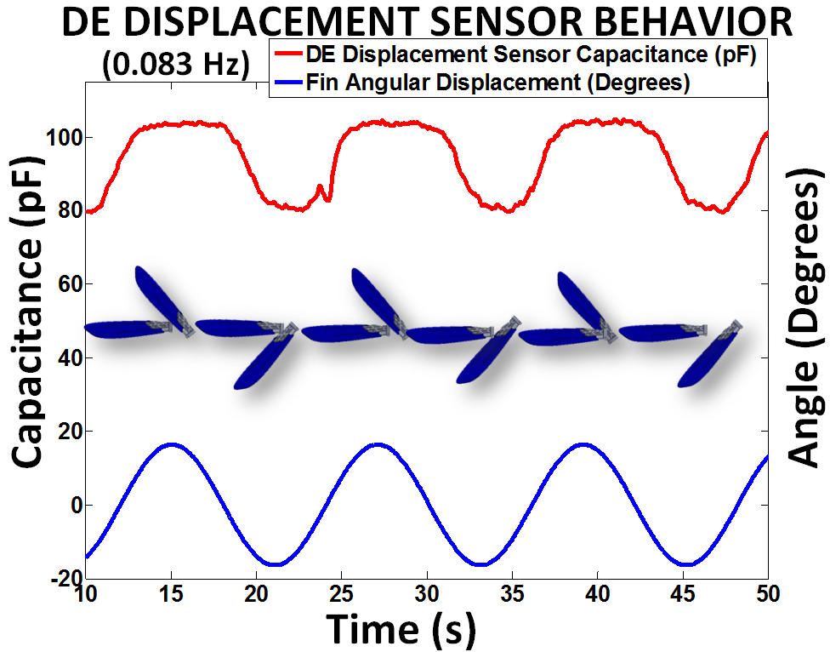
DE Displacement Sensor Readings Show Direct Correlation With Fin Oscillation
Intro
Aim
Design
Behavior Analysis
Results
Conclusion
Future Work
Notes:
<number>

Slide 19
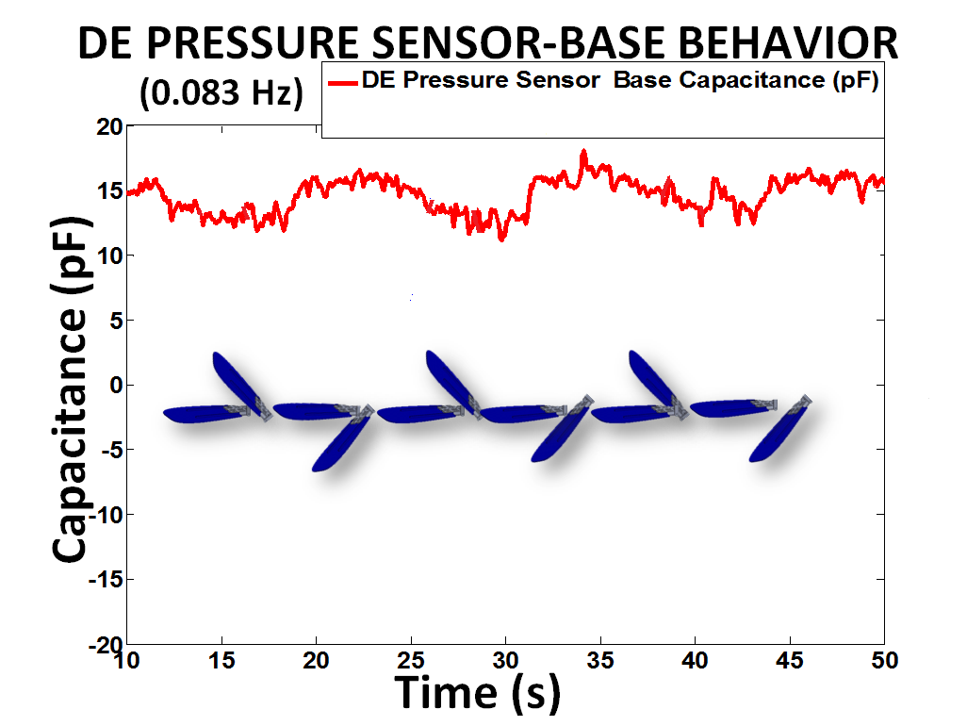
DE Pressure Sensors Work Extremely Well Under Water
Intro
Aim
Design
Behavior Analysis
Results
Conclusion
Future Work

Slide 20
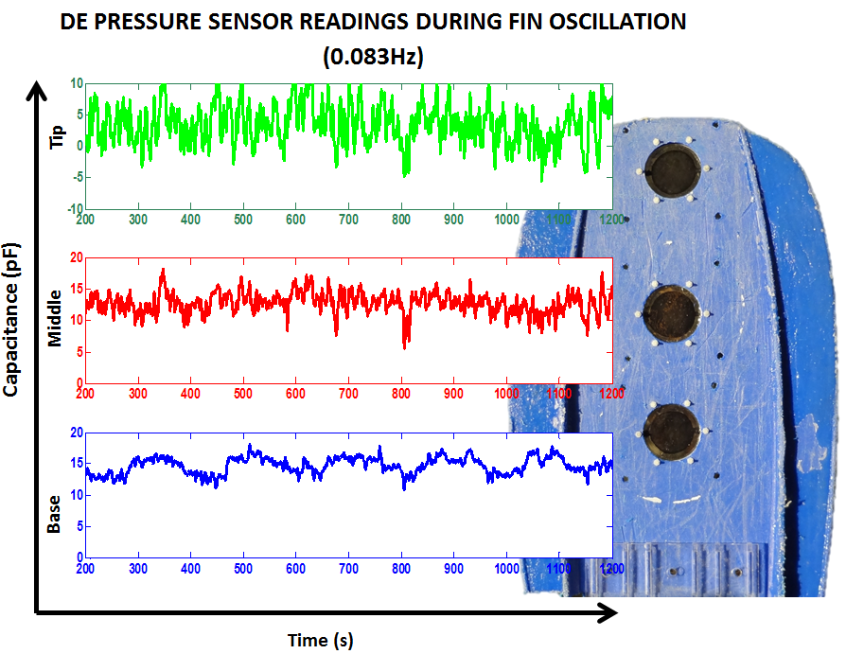
The Pressure Sensors Detect a Variation in Pressure Along the Fin
Intro
Aim
Design
Behavior Analysis
Results
Conclusion
Future Work
Notes:
PUT VIDEO!!!!!!!!!!!!!!!
Take out displacement sensor, put in a line,
<number>

Slide 21
Conclusion
Successfully developed a pneumatically driven finning system
Capable of sensing the conditions of pressure flow around its fin
Proprioceptive knowledge of fin location at any time
Successfully developed DE sensors capable of being submerged under water
High accuracy
Fast dynamic response
Compliant
Successfully made a displacement strain gauge sensor
Useful for any applications where a low stiffness strain gauge is required
Intro
Aim
Design
Behavior Analysis
Results
Conclusion
Future Work
Notes:
Strain gauge is useful for other applications where a low stiffness strain gauge is required.
<number>

Slide 22
What Are the Potentials For Future Development?
Create a pressure sensing array
Optimize number
Optimize position
Hydrodynamic realization
More integrated sensor-fin design
Automated sensor fabrication for increased uniformity
Intro
Aim
Design
Behavior Analysis
Results
Conclusion
Future Work

Slide 23
What Are the Potentials For Future Development?
Implementing feedback control
Desired Hydrodynamics
+
-
Controller
Actuator
Fin
DE Strain Gauge
DE Sensor
Endless possibilities
Intro
Aim
Design
Behavior Analysis
Results
Conclusion
Future Work

Slide 24
Acknowledgments
Dr. Iain Anderson
Christoph Peuckert
The Biomimetics Laboratory
Todd Gisby
Thomas McKay
Samuel Schlatter
Scott Walbran
Andrew Lo
Tony Tse
Peter Blythe and Michael Byrne
Geoff Kirkby
Festo New Zealand

Slide 25
Thank you! Questions?

